Slide 1
Self-Monitoring
The missing dimension of Cancer Survivorship

Slide 2
Why would you be interested in a cancerousness measure?

Slide 3
Why would you be interested in a cancerousness measure?
47% of people will be diagnosed with cancer at some time in their lives by 2020

Slide 4
Why would you be interested in a cancerousness measure?
47% of people will be diagnosed with cancer at some time in their lives by 2020
30% will die of it

Slide 5
Why would you be interested in a cancerousness measure?
47% of people will be diagnosed with cancer at some time in their lives by 2020
30% will die of it
survivors will live many years with it

Slide 6
So it may be of interest to know if you are getting better or worse

Slide 7
So it may be of interest to know if you are getting better or worse now and then

Slide 8
Alas, the doctors will only be able to tell you when it is changed big time
“The lumps are bigger”
“The shadows are smaller”
Than 3/6/12 months ago

Slide 9
What they cannot tell you is whether you are getting better or worse week by week; in practice, often hardly month by month

Slide 10
Now, you know that something’s are supposed to help, and something's harm:
exercise, no smoking, no alcohol, no obesity, and many things touted on the web
But: are they actually working in your case?
You want/need to know at least weekly, if not daily – in between doctor visits
What to do?

Slide 11
You can do molecular cancer markers, not much favoured by most of the doctors I’ve had.
These require a sample to be sent away, with results a week or so later.
Useful, but still a time delay

Slide 12
Of course, what you’d really like, is a more or less continuous – perhaps daily (a hypochondriacs dream) – indication of whether you are getting better or not.

Slide 13
When I was diagnosed with terminal cancer and told there was nothing they could do for me;
go home and make final preparations;
I did what any self-respecting QSer would do:
I started measuring even more of my lifestyle in the hope of surviving longer.

Slide 14
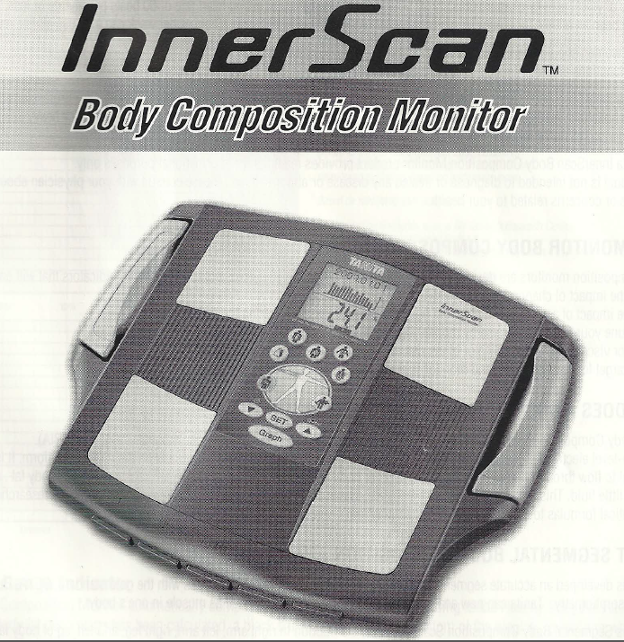
Amongst the many things I did, was buy a body composition monitor

Slide 15
Another thing I did, against the advice of the doctors (“waste of time; they only tell you you’ve got cancer – and we know you do have”), was to do molecular cancer markers – just occasionally at first, now monthly. This became a measure of my cancerousness; because they do actually come with a continuous scale.

Slide 16
With this, I can measure a whole range of body composition things – weight, fat, muscle-mass, water, and – most importantly – of each limb.
From the latter, I could calculate the differences.
Why would I do this? Initially, for no other reason than I am a nerd/geek – I like playing with numbers.

Slide 17
In the fullness of time, with my constant looking at all these numbers graphically, I noticed that the – I have to be careful here – the difference of the fat of each leg (OK, I nearly said something like: “the fat between the legs”; oops, there, I did it) seemed to roughly parallel the changes in cancerousness

Slide 18
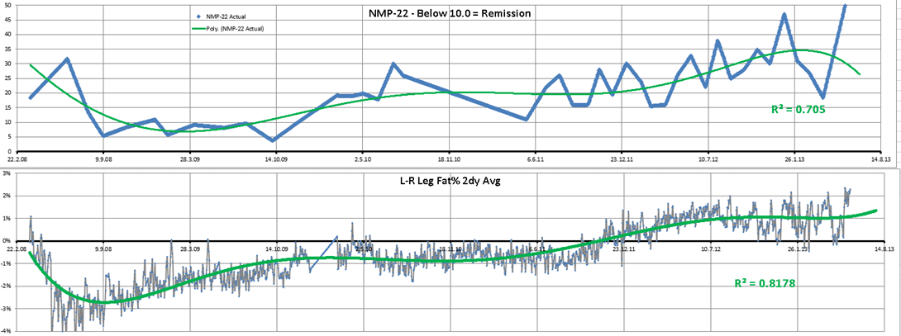
And so to the results
First, the graphs of the cancerousness and the leg out-of-balanceness
Note: Initial diagnosis Oct ‘07; chemo Feb-Jul ‘08; some cancer June ’11; worse Jan ’13; chemo Mar-Apr ‘13

Slide 19
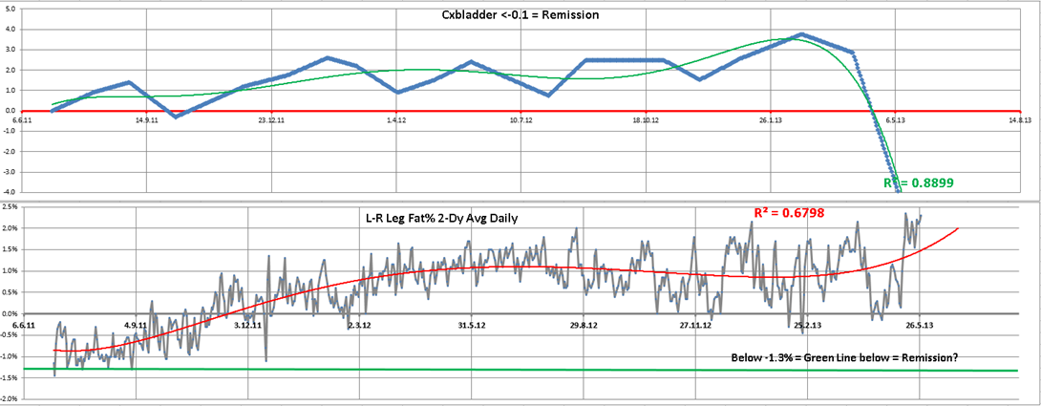
And the second one, specific to my cancer: Cxbladder (the other two are more general)

Slide 20
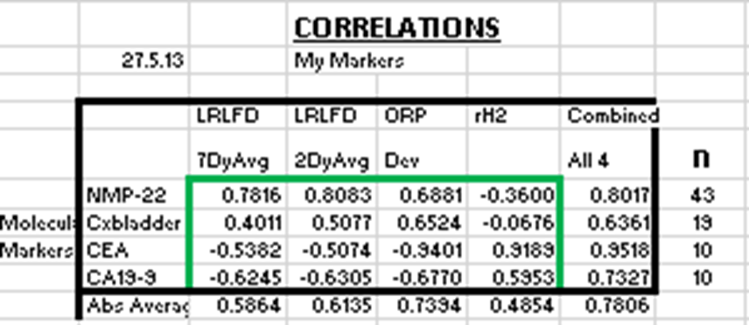
Next, the stats: the correlation between the molecular cancer markers and my cancer markers – of which I found 4: two body composition ones and two urine ones

Slide 21
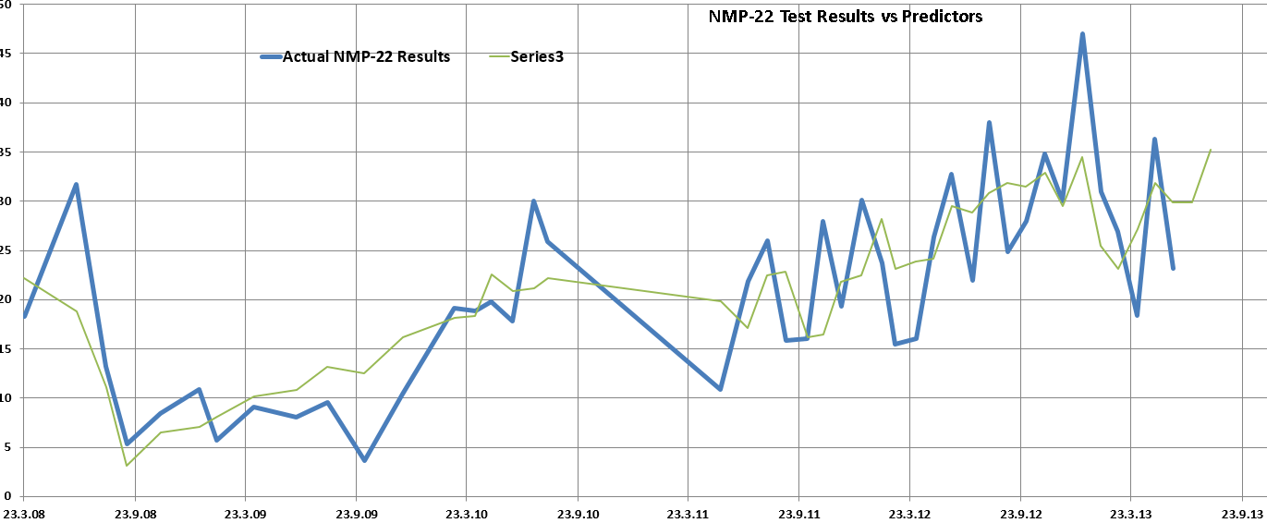
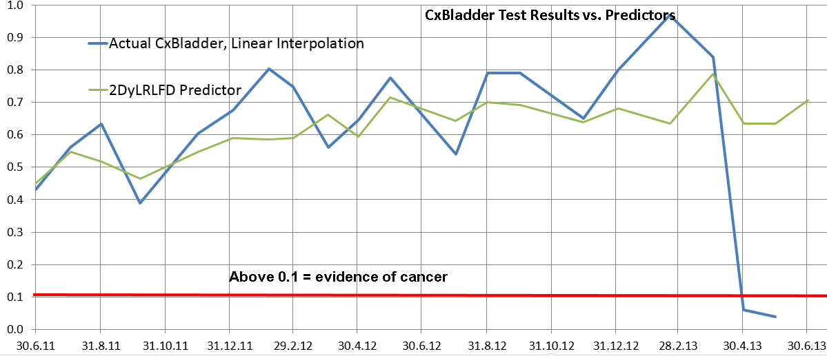
Plot of Molecular Cancer Marker NMP-22 vs. 2 Day Avg. L-R Leg Fat Difference -74 Days
Plot of Molecular Cancer Marker Cxbladder vs. 2 Day Avg. L-R Leg Fat Difference

Slide 22
The take-home message from the previous table is that there are easy surrogates to the molecular biomarkers, that are both available to the patient and could be done daily, and can be done inbetween times for self-assessment
That of the fat difference of the legs is the one I think is credible, easy, repeatable, and a continuous metric usable for data analysis. However, neither my biomarkers nor the molecular ones are a substitute for the traditional assessments that the medical professionals do.

Slide 23
Please note:
This is not a substitute for the consulting with medical experts – it is something to use inbetween visits to them
My theory is not yet proven – tho’ there’s a lot of supportive research (see my blog - www.bladdercancerfight.blogspot.co.uk)
This out-of-balanceness may turn out to be a general health measure – something like a thermometer, and so have wider application

Slide 24
Finally
Self-monitoring with a body composition monitor is a useful tool for assessing cancer progress between doctor visits, potentially allowing lifestyle relationships with it to be explored.

